Slide 1
https://github.com/Jandev/adr-cli
Notes:
https://github.com/Jandev/adr-cli

Slide 2
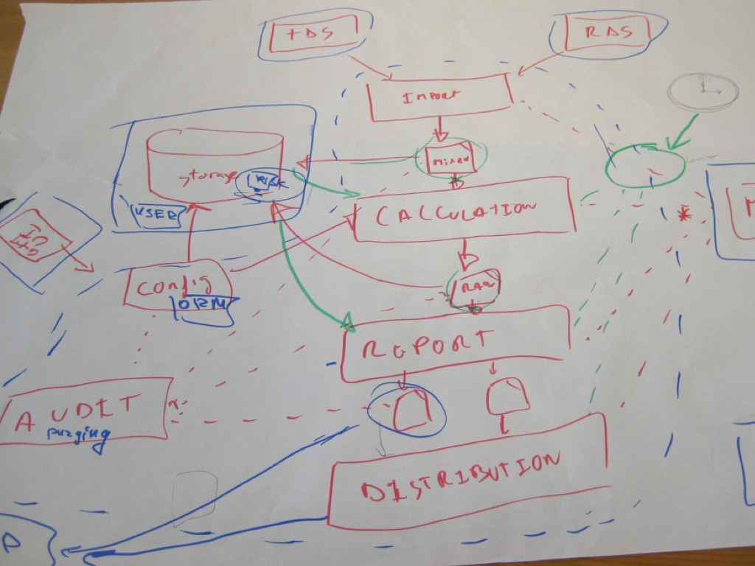
Notes:
We also need to do something about diagrams

Slide 3
c4model.com

Slide 4
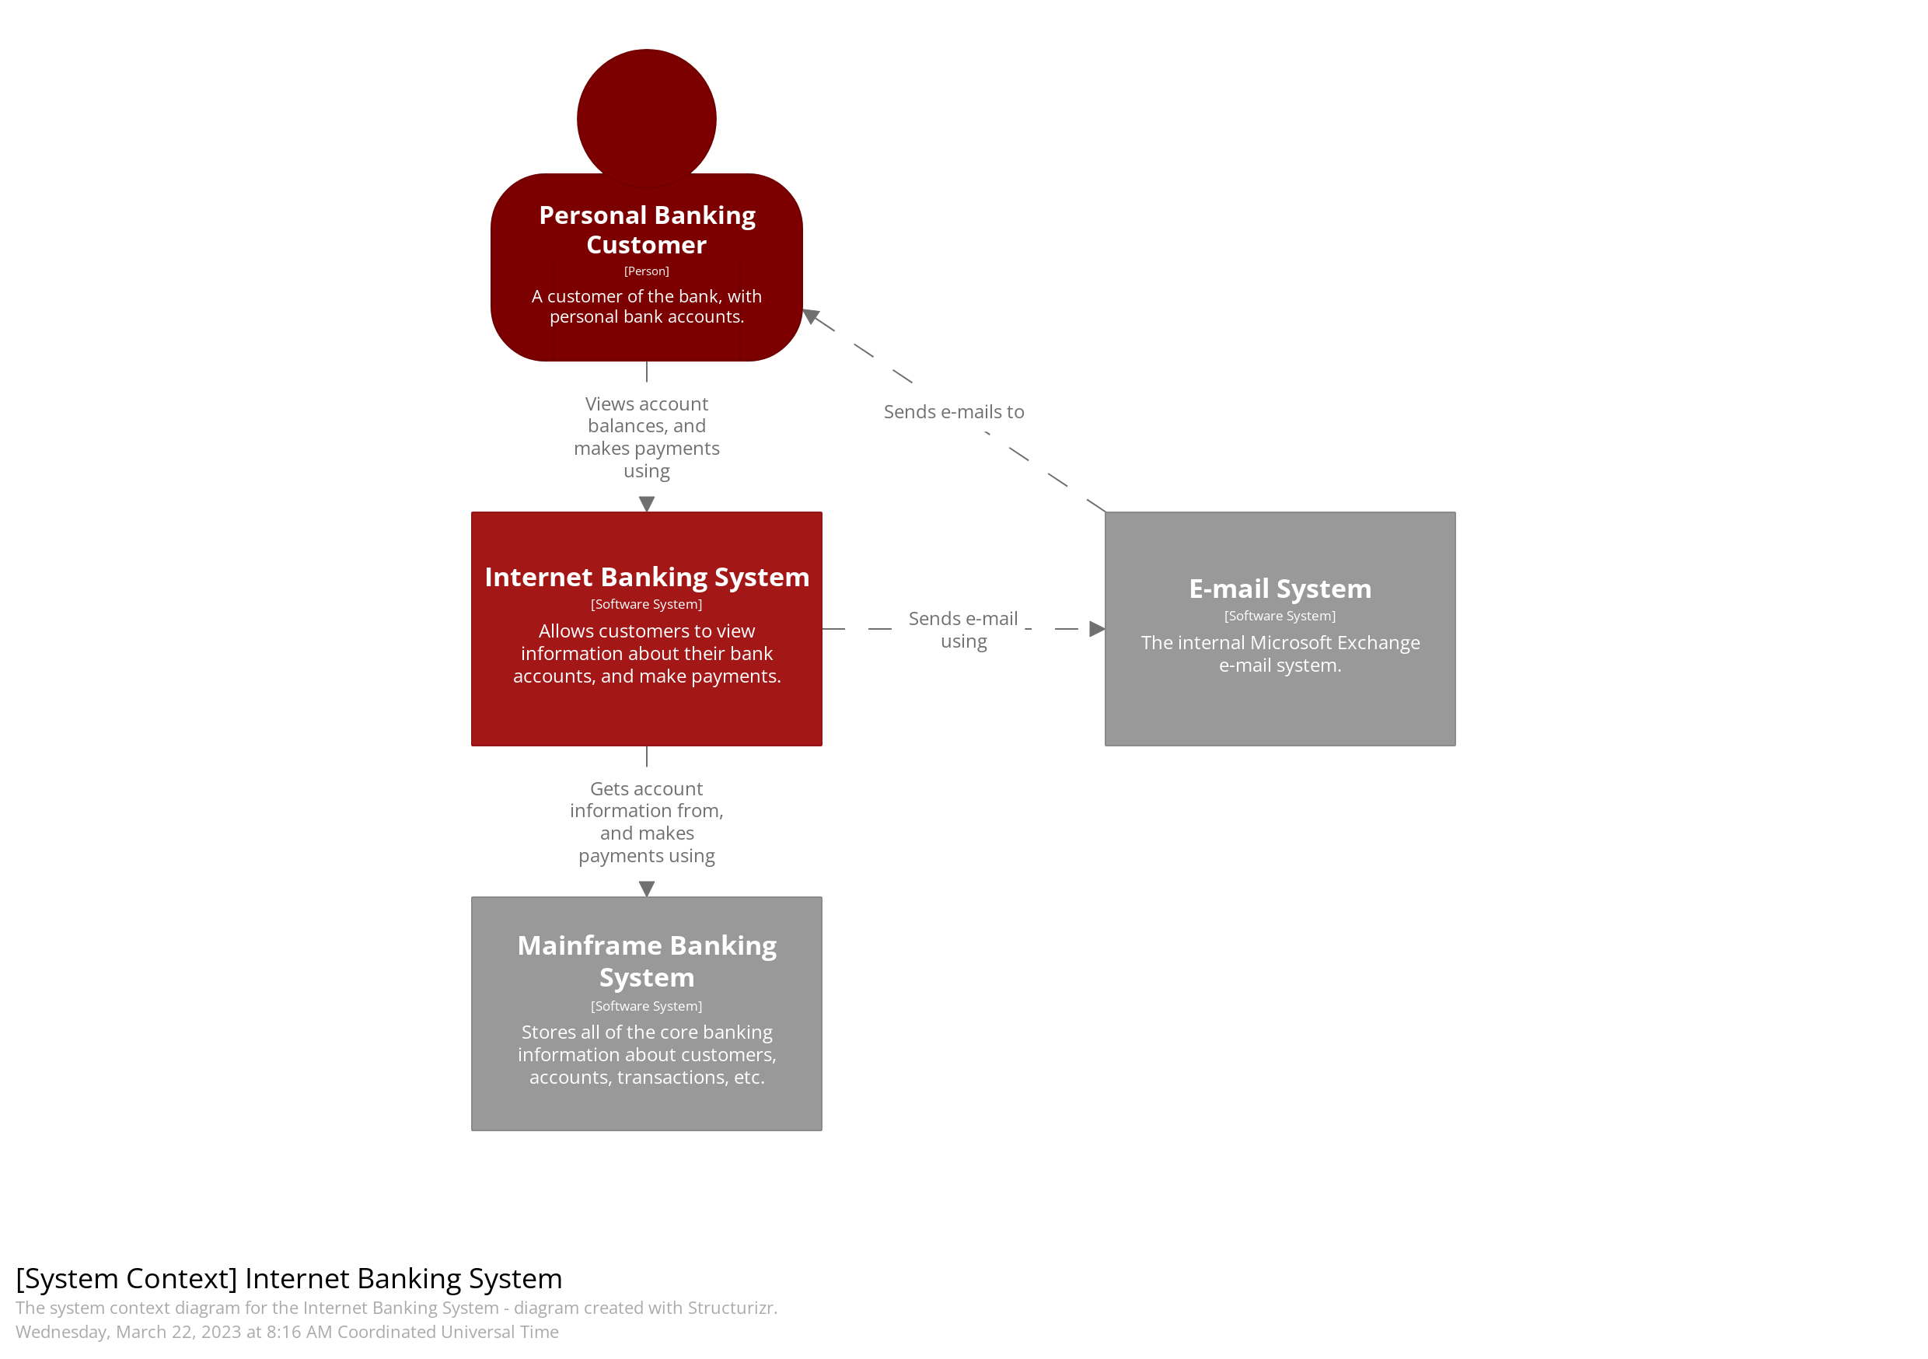
Notes:
Context

